Slide 1

Accident Preventer
Team: Phoenix
Riti Agarwal
Tanmay Dhaundiyal
Nikhil Jindal
Rutuja Oza
MindSpark

Slide 2

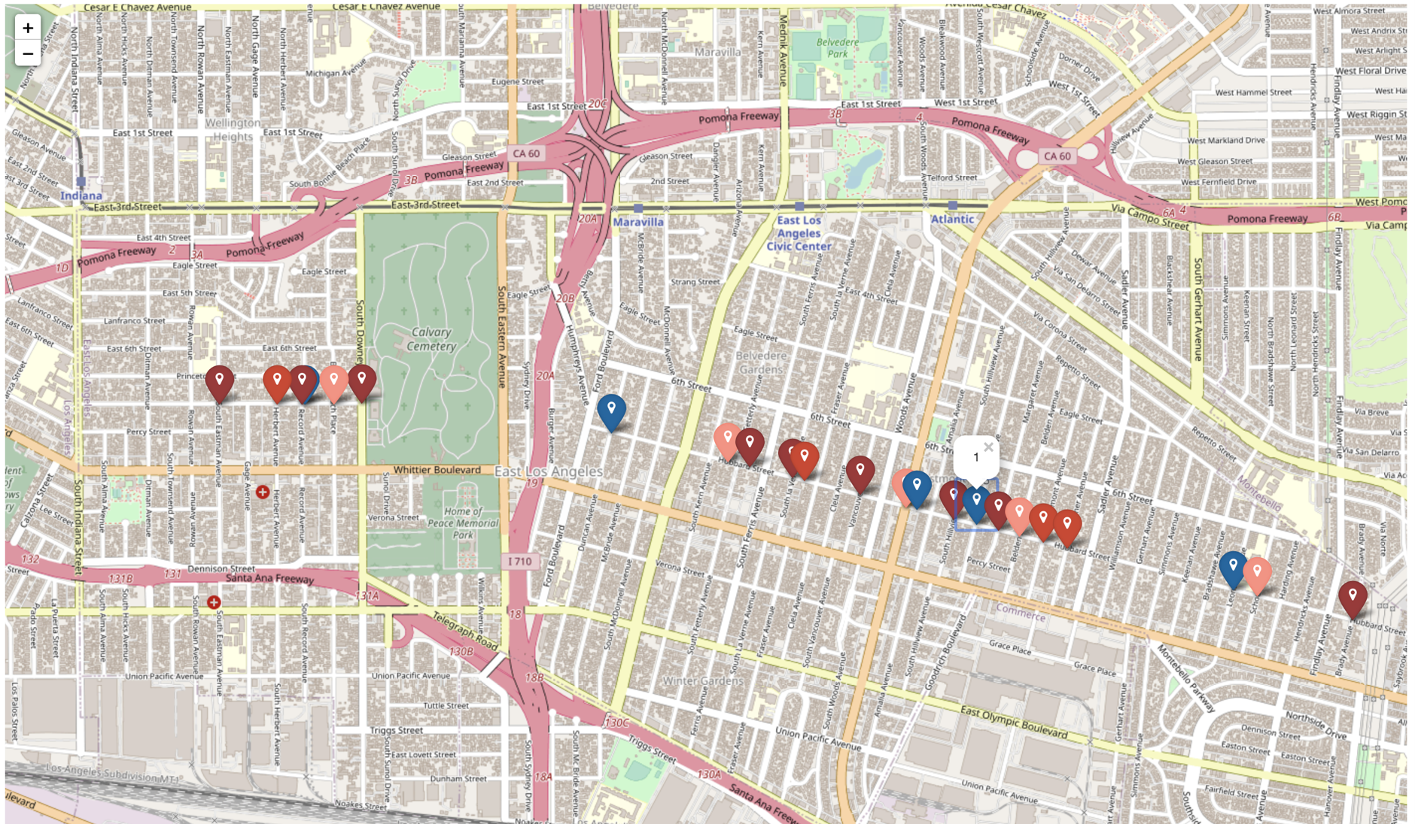
Impact and Use Case
31720 accidents in 2021, 12% increase since 2020
Accurately predicts accident severity at accident prone points on a route
Based on real time weather forecast
Alerts the drivers

Slide 3
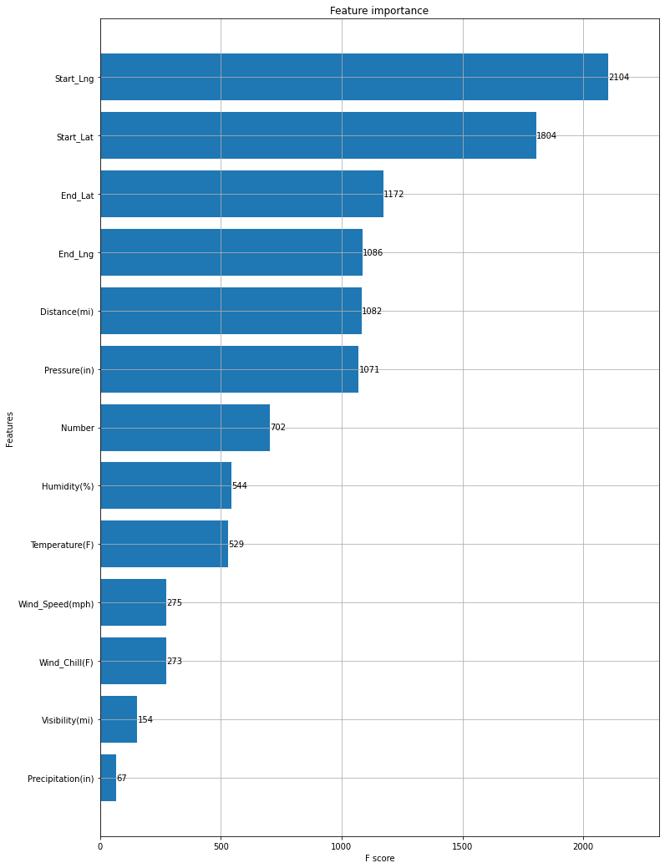
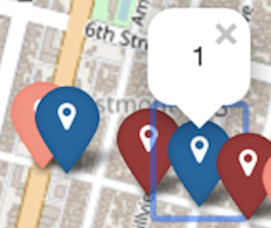
Dataset description
USA Accidents Data for 2019-2021
About 1 million data points, 47 features, 7 features
Feature Extraction for top 7 features
Start Longitude, Start Latitude,
Pressure(in), Humidity(%)
Temperature(F) Wind_Speed(mph)
Visibility(mi)
Predicting ‘Severity’: 1, 2, 3, 4

Slide 4



What did we do
Step 1
Step 2
Data Preparation
Feature Extraction
Data Cleaning
Prediction:
Analyzed and Implemented various algorithms
Choose appropriate features
Tuned hyperparameters
Application Building:
Used Weather API
Implemented Frontend
Step 3

Slide 5
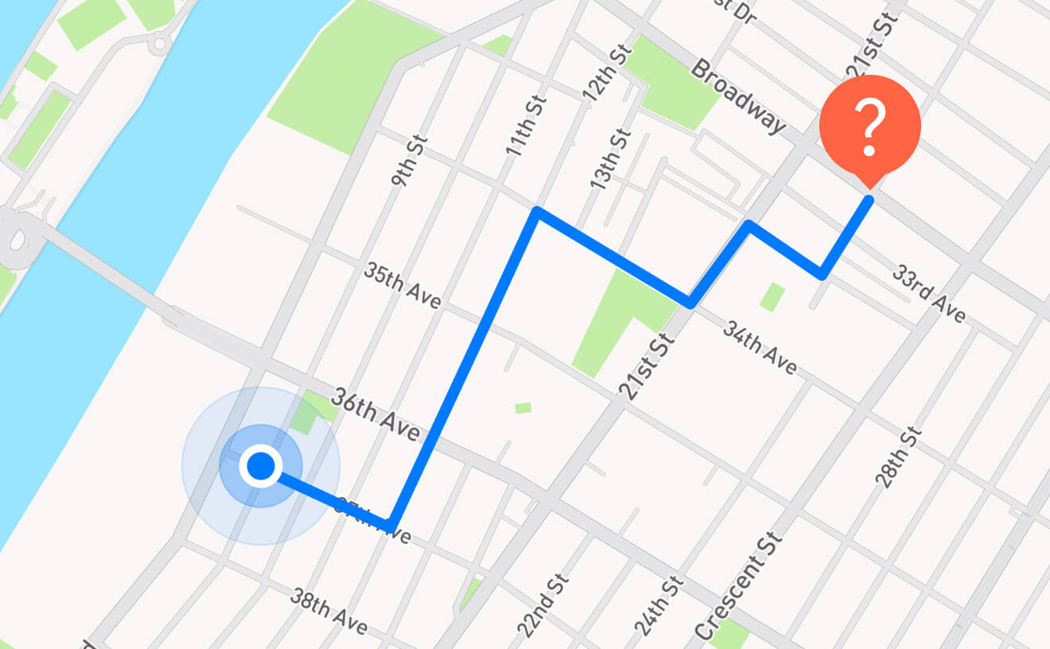
Scope
Proposed Solution
Source
Destination
Safest Path
Less Accidents
Prototype
Street start = Source
Street end = Destination
How severe the accidents on the street can be

Slide 6
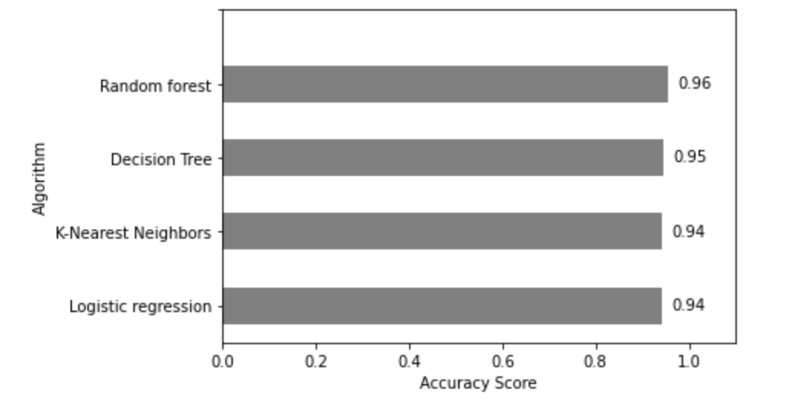
Why This Model?
Analysed 4 models:
Random Forest
Decision Tree
K-Nearest Neighbors
Logistic Regression
Reasons to Choose Random Forest:
Better performance for classification problems
Great with High Dimensionality
Robust to Outliers and Non-linear Data
Drawbacks:
Large data sets takes lot of memory and computational time
Large number of features can cause overfitting

Slide 7
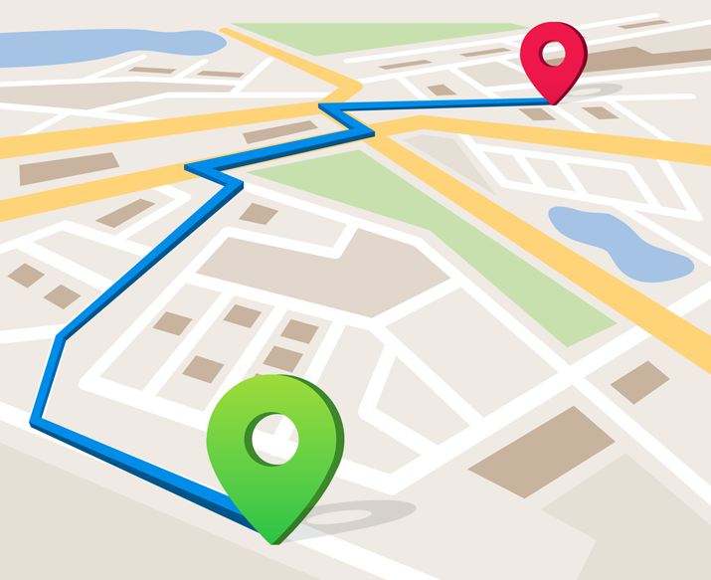

Challenges and Future Scope
Challenges
Large and inaccurate data: Uneven number of instances of classes
Difference in metrics for the weather api and dataset
Deciding top features and suitable training model
Future Scope
Predicts accident prone spots from start to end destination
Safest route with less accident prone streets
Time to safely travel through the route

Slide 8
Thank You
Drive Safe!
Take Care!

